Slide 1


Slide 2
Interesting facts about Japanese schools

Slide 3
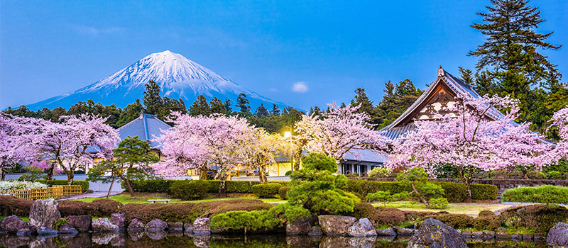
The start of school year

Slide 4
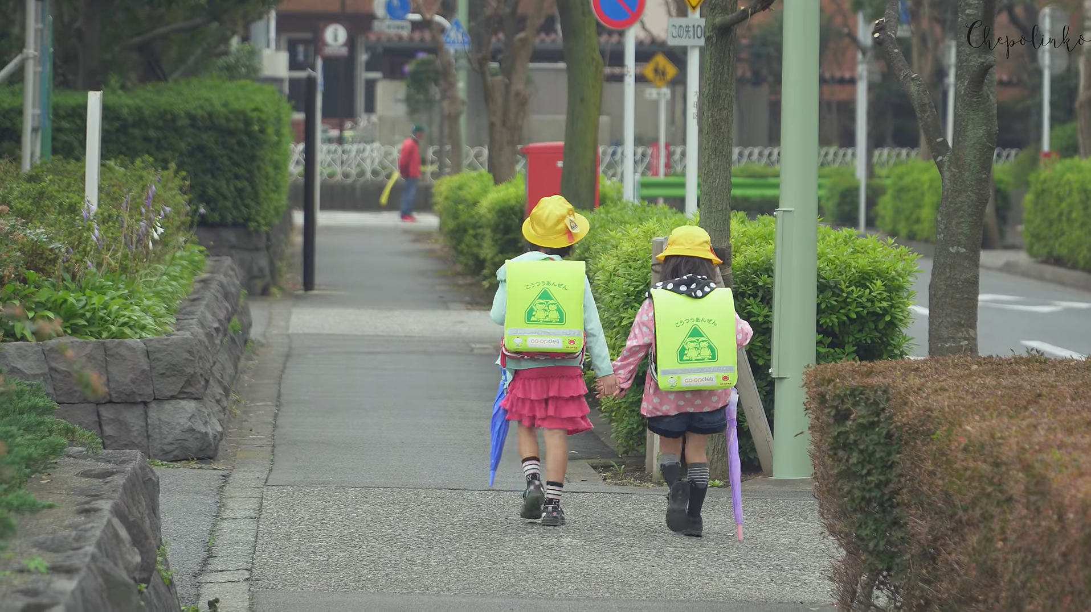
How pupils get to school

Slide 5
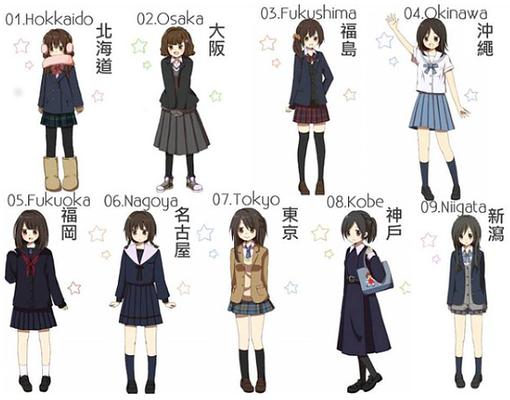
School uniforms

Slide 6
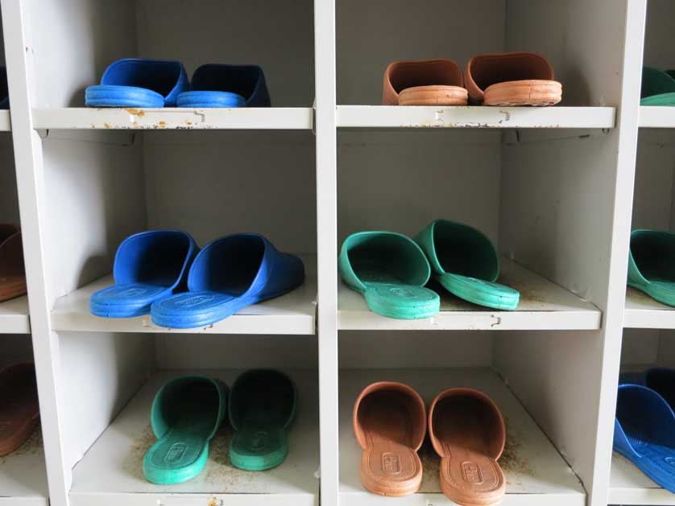
School shoes and outdoor shoes

Slide 7
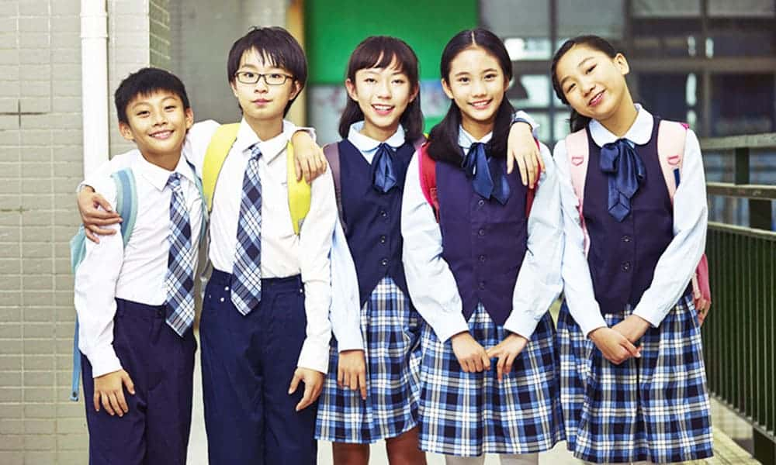
Appearance rules

Slide 8
6 years of elementary school,
3 years of junior high school,
3 years of senior high school and
4 years of University

Slide 9
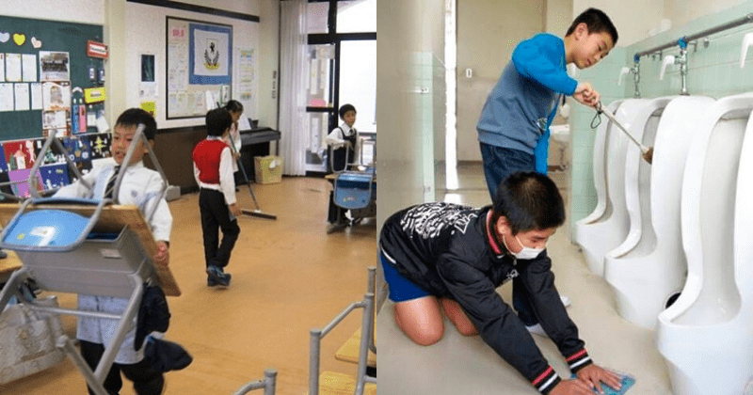
There are no cleaners in schools

Slide 10

No exams for the first 3 school years

Slide 11
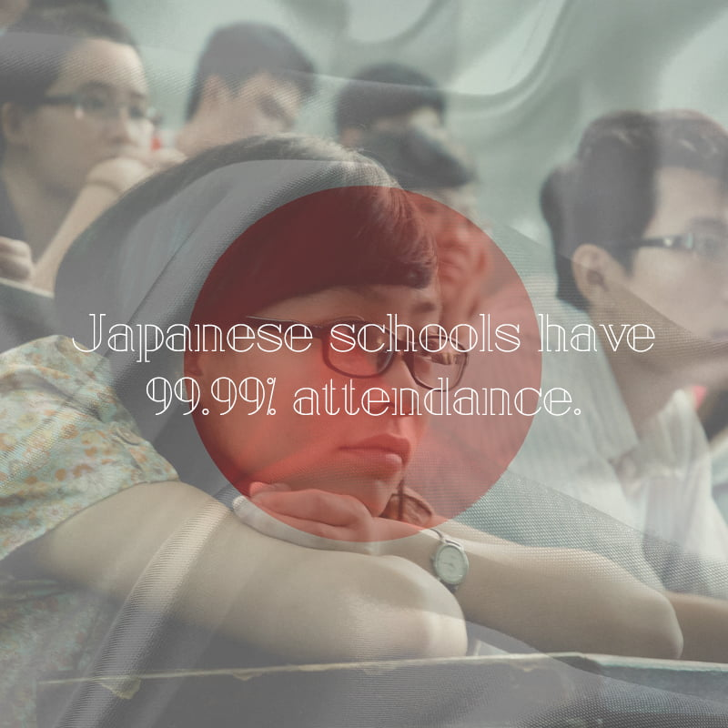

Slide 12
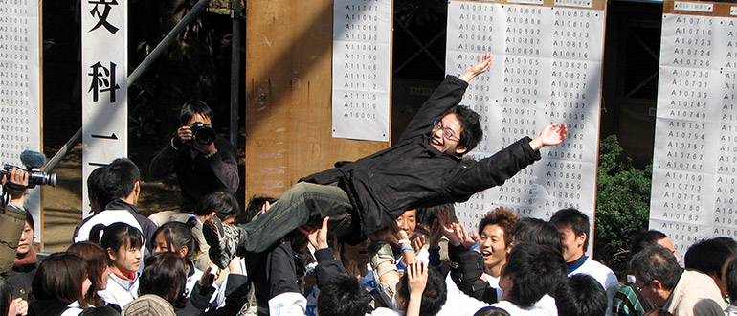
One final exam

Slide 13
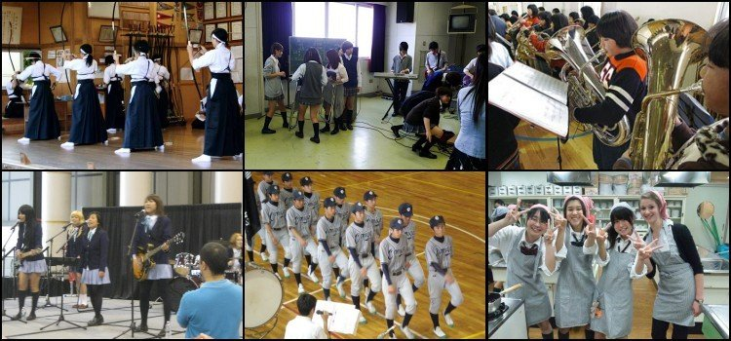
There are clubs

Slide 14
Thanks for your attention ☺

